Slide 1
Cost Estimation System
Technical Implementation Discussions

Slide 2
Agenda
Cost Estimation System – Technical implementation Approch
1
Introduction to the Cost Estimation System
2
Project Overview
3
Database Migration Needs
4
Proposed Database Schema Design
5
Challenges in Database Migration
6
User Interface Architecture
7
UI and Framework Approach
8
Reporting Framework
9
Data Migration Strategy
10
Complexity and Deliverables Overview
11
Pros and Cons of Proposed Approaches
12
UI Demo, Conclusion and Future Work, QA

Slide 3

Project Overview
Objective, Problem Statement, Complexity Overview, Existing Challenges
Project Objective: To establish a comprehensive estimate framework that uses new technology, which will be easy to maintain
Problem Statement: The current cost estimation is using out of support software tools, adding more technology risk.
Complexity Overview: The project entails a complex architecture – Database redesign, Data migration from Oracle database to SQL 2022 database
Photo by Isaac Smith on Unsplash

Slide 4

Complexity and Deliverables Overview
UI Screens, Database Object, SSO, Reports, IFS Data Fetch
Number of UI Screens: Overall UI consists of multiple screens, specifically: Parts (8), Vehicles (8), Labor (6), Costs (5), Vehicle Types (5), and Reports (6).
Database Objects Overview: In total, our design will feature 87 tables, 7 views, 24 stored procedures, and 6 SQL functions that will drive the application.
SSO Overview: 4 types of users. SSO solution for authentication and authorization. 6 Reports. .
Reports: Application generates 6 reports
Data from IFS Database: Application needs data from IFS database in daily basis
Photo by Amélie Mourichon on Unsplash

Slide 5

Database Migration Needs
Challenges of Oracle to SQL Server, Schema Analysis, Migration Complexity, Number of Tables and Stored Procedures
Challenges of Migration: Transitioning from Oracle to SQL Server presents complexities such as schema incompatibility and lack of existing constraints.
Number of Database Objects: In this migration effort, we are dealing with 87 tables, 7 views, 24 stored procedures, and 6 SQL functions, all necessitating careful planning.
Schema Analysis Importance: Understanding the current Oracle schema is crucial for designing a new structure that can incorporate foreign key constraints and normalization.
Migration Complexity Factors: Challenges related to reference data and ensuring data integrity throughout the migration process pose significant obstacles.
Photo by Taylor Vick on Unsplash
Notes:
As we delve into the database migration needs, the complexity arises from the inherent differences between Oracle and SQL Server. Not only do we face technical challenges, such as obsolete schemas and missing constraints, but we must also manage a considerable number of database objects that require meticulous planning. A thorough schema analysis is essential to guide our design towards a more robust structure that ensures data integrity throughout our migration efforts.

Slide 6
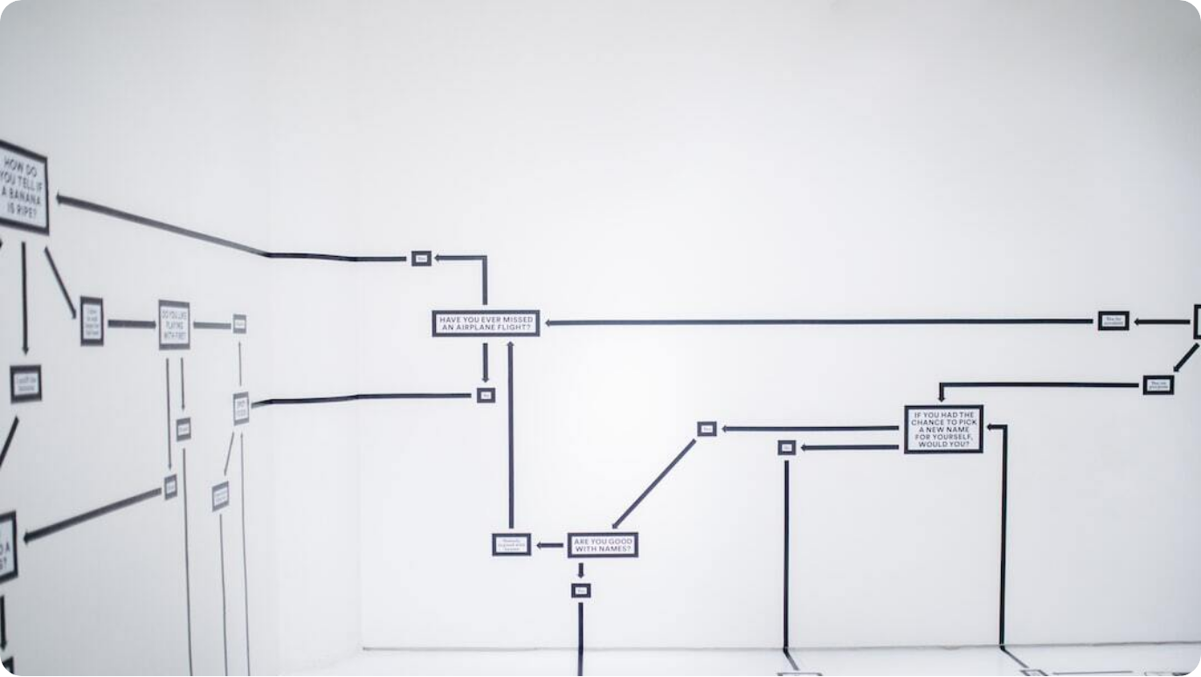
Proposed Database Schema Design
New Schema Development, Foreign Key Constraints, Phase-wise Migration Approach, Major Deliverables
New Schema Development: The design of the new schema will incorporate foreign key constraints to enhance data integrity and enforce relationships between entities.
Phase-wise Migration Approach: The migration will be carried out in phases, starting with essential components, and iteratively refining each stage to adapt to changes.
Major Deliverables: Key deliverables include the finalized database schema and mapping document to ensure clarity in the migration process.
Photo by Hanna Morris on Unsplash

Slide 7



Challenges in Database Migration
Obsolete Schema, Lack of Constraints, Iterative Migration Process, Data Mapping Considerations
Obsolete Schema Issues
Old schemas create barriers to effective migration due to their lack of constraints and outdated structures that hinder adaptation.
Iterative Migration Process
Iterative migration allows for flexibility in design but may complicate integration as changes in one aspect impact others.
Data Mapping Considerations
Careful consideration of how data in the old system maps to the new schema is critical to ensure data integrity and usability post-migration.

Slide 8




Data Migration Strategy – Existing Oracle DB to SQL 2022 DB
One-time Data Migration, SSIS - SQL Server Data Tools, Reusable Functions from Oracle to SAP, Nightly Batch Jobs
One-time Data Migration
The planned data migration will occur once, facilitating a straightforward transition to the new schema without ongoing interference.
SSIS - SQL Server Data Tools
Leveraging SSIS for data tasks allows for smooth data extraction, transformation, and load processes during migration.
Reusable Functions
The potential for reusing functions designed for Oracle in the new SQL Server context enhances efficiency and minimizes development redundancy.
Nightly Batch Jobs
SSIS windows sscheduled nightly jobs will ensure that updated data from the IFS Oracle system feeds seamlessly into the new SQL Server setup.
Notes:
Our data migration strategy focuses on a one-off transfer from Oracle to SQL Server, ensuring a clean slate for the new schema. We will employ SQL Server Integration Services (SSIS) to facilitate data transformation and loading processes, taking full advantage of existing reusable Oracle functions. Nightly batch jobs will keep our new database updated with legacy system data, ensuring continuity and relevance as we transition to the new platform.

Slide 9
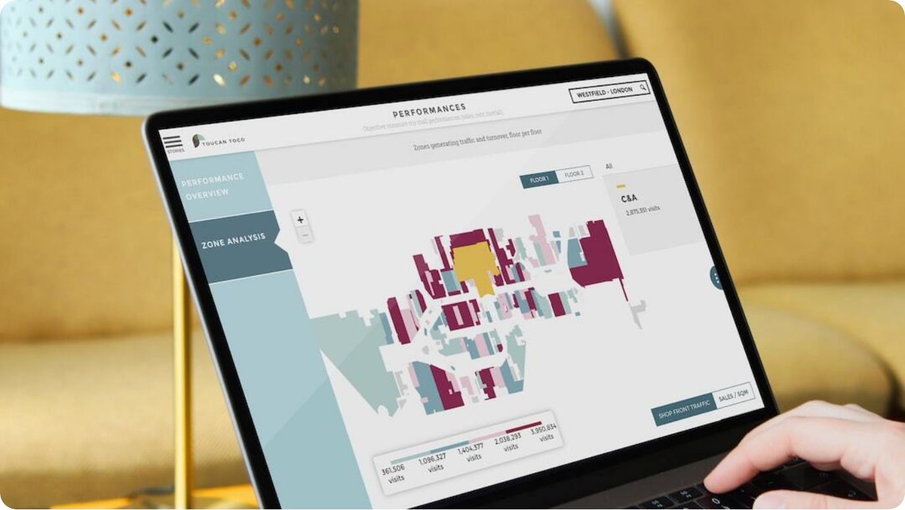
User Interface/SSO Implementation
UI Components Overview, Authentication and Authorization, Structure of Screens, User Levels and Permissions
UI Components Overview: The user interface will consist of various components tailored to enhance user experience, with a focus on intuitive layouts and functionality.
Authentication and Authorization: Utilization of the MS Identity Framework for robust security and Single Sign-On capabilities, ensuring no passwords are stored in the database.
Structure of Screens: A structured layout with Overall UI consists of multiple screens, specifically: Parts (8), Vehicles (8), Labor (6), Costs (5), Vehicle Types (5), and Reports (6)ASP.NET Core models will be used.
User Levels and Permissions: A permission-based architecture will dictate user access levels, ensuring secure handling of sensitive data throughout the application.
Photo by Adrien WIESENBACH on Unsplash

Slide 10

UI and Framework Implementation Approach
ASP.Net Core 8.0.4, Benefits of Razor, Telerik Controls
ASP.Net Core 8.0.4: Leveraging the latest framework version ensures we utilize the most efficient and powerful features for web development.
Benefits of Razor Views and Models: Razor offers less spaghetti code, streamlined development without controllers, and better support for functional requirements, enhancing maintainability.
Telrik UI MVC Controls Integration: Integration of Telerik controls facilitates a more responsive interface, improving user experience and reducing page load times.
Development Benefits: This approach fosters faster development times and supports maintenance efforts, allowing for gradual adaptations to user feedback.
Photo by Blake Connally on Unsplash

Slide 11

Reporting Framework
Report Generation Options, Pros/Cons of SSRS vs. Telerik, Reporting Requirements, Backend Logic Integration
Report Generation Options: We’ll be evaluating report generation using SSRS versus Telerik Kendo controls, each with distinct benefits.
Pros of SSRS: SSRS allows for extensive functionality and can integrate seamlessly with SQL Server for diverse reporting needs.
Pros of Telerik Kendo: Kendo offers more modern UI capabilities and ease of use, particularly beneficial for web applications seeking interactive reporting solutions.
Backend Logic Integration: All report logic will reside in the backend, ensuring that the new schema supports effective data manipulation and retrieval for reports.
Photo by Alvaro Reyes on Unsplash
Notes:
In evaluating our reporting framework, we must weigh the options between SSRS and Telerik Kendo controls. While SSRS brings in-rich functionalities well-suited for a vast array of reporting needs, Kendo’s modern user interface offers enhanced interactivity, crucial for engaging user experiences. Both options will rely on backend logic for data integration, ensuring our reports pull accurate, relevant data that aligns with our migration efforts.

Slide 12




Pros and Cons of Proposed Approaches
Ease of Implementation, Maintenance Factors, Performance Considerations, Flexibility and Scalability
Ease of Implementation
Streamlined design and development processes reduce implementation complexities, enabling rapid deployment of the new system.
Maintenance Considerations
The modular approach simplifies maintenance, promoting easier updates and adaptations as business needs evolve over time.
Performance Factors
Adopting a new schema can enhance performance by reducing load times and optimizing database queries.
Flexibility and Scalability
The proposed architecture is designed for scalability, ensuring that future enhancements and integrations with IFS SAP can be accommodated effortlessly.
Notes:
Finally, we weigh the pros and cons of our proposed approaches. The streamlined design significantly eases implementation challenges, while modular structures promote an agile maintenance experience. Performance will benefit from our decisions, leading to fast query execution and reduced load times. Flexibility and scalability are integral to our architecture, ensuring that we can grow and adapt our solutions in synergy with changing business demands.

Slide 13




Conclusion and Future Work
Key Insights, Next Steps, Importance of Efficient Cost Estimation, Final Thoughts
Key Insights
A dependable solution that leverages supported tools and remains easy to maintain in the future is crucial.
Next Steps
Move towards implementation of the database schema generation and migration and UI design by phased project approach.
Enhanced Performance and Scalability
The Utilizing ASP.NET Core 8.0, combined with Telerik controls for rich UI components, ensures high performance and scalability, making it ideal for handling large-scale applications. The integration of SSIS for data integration and reports for data visualization further optimizes data processing and reporting capabilities.
Improved Efficiency and Security
The migration to SQL with a new schema design, coupled with SSO and ASP.NET, enhances data management efficiency and user security, aligning with modern IT standards.
Notes:
In conclusion, we reflect on the vital insights we've uncovered throughout this project related to cost estimation with the emphasis on operational efficiency. The subsequent steps are clear, guiding us towards the implementation phase while affirming our dedication to tackling budget challenges effectively. The ultimate goal of this endeavor transcends mere financial accuracy; it aims to reshape how businesses approach cost estimation, establishing new benchmarks in both efficiency and reliability.

Slide 14
UI Demo
UI Demo
UI Demo
ASP .NET Core
Telerik Kendo ASP MVC UI Controls
Razor Pages
Interactions with Database
Notes:
In conclusion, we reflect on the vital insights we've uncovered throughout this project related to cost estimation with the emphasis on operational efficiency. The subsequent steps are clear, guiding us towards the implementation phase while affirming our dedication to tackling budget challenges effectively. The ultimate goal of this endeavor transcends mere financial accuracy; it aims to reshape how businesses approach cost estimation, establishing new benchmarks in both efficiency and reliability.

Slide 15
QA
QA
Q/A?
Notes:
In conclusion, we reflect on the vital insights we've uncovered throughout this project related to cost estimation with the emphasis on operational efficiency. The subsequent steps are clear, guiding us towards the implementation phase while affirming our dedication to tackling budget challenges effectively. The ultimate goal of this endeavor transcends mere financial accuracy; it aims to reshape how businesses approach cost estimation, establishing new benchmarks in both efficiency and reliability.

